Slide 1

Generative AI for Muography
Author : Shaivya Shankar, Supervised by Dr.Sudarshan Premavarsan and Dr.Florian Bury

Slide 2
Main Questions
Finding Optimal GAN for Muon Propagation ?
Key topics Covered:
implemented Vanila GAN based on 2014 GAN.
Explored different scaling techniques.
Various Normalization technique for stablizing the Data For GAN

Slide 3
What is muography
The core of muography is understanding a muon's trajectory through matter. We use natural cosmic-ray muons to create density maps of large-scale structures like volcanoes or pyramids.
Predicting these paths requires computationally expensive simulations like Geant4. This is because a muon's journey is inherently random, or stochastic.
governed by the complex physics of its interactions at every step. While Geant4 is the gold standard for accuracy, its step-by-step simulation process is very slow.
This computational cost is the primary motivation for this project. The time required to generate millions of tracks for a high-resolution image creates a significant bottleneck in the field, limiting research and rapid prototyping.
The goal is to solve this by developing a fast, AI-based model—a Generative Adversarial Network (GAN)—that learns the underlying probability distribution of these physical interactions directly from Geant4 data. The GAN learns to instantly predict the outcome of a simulation step (the changes in momentum, angle, and position) based on the muon's current state.
By replacing the intensive step-by-step calculation with a single forward pass of a neural network, the GAN can serve as a high-speed complement to traditional methods, enabling studies that would otherwise be computationally prohibitive.

Slide 4
The Physics of a Single Muon Step
The simulation of a muon's path is modeled as a sequence of discrete steps. The nature of these steps is primarily determined by the properties of the material the muon travels through, which is characterized by a single parameter:
Radiation Length (X₀): A fundamental property of a material that quantifies how effectively it causes a high-energy particle to scatter and lose energy.
This material property then directly influences the three key outcomes of any single interaction step:
Momentum Loss (-ΔP)
The energy the muon loses, primarily through ionization. The magnitude of this loss is strongly dependent on the material's density, which is related to X₀.
Scattering Angle (Δθ)
The random change in the muon's direction due to Multiple Coulomb Scattering. The magnitude of this scattering is directly governed by the material's Radiation Length (X₀).
Step Length (Δr)
The physical distance the muon travels in one step. This distance is also determined by the material properties encapsulated by X₀; steps are much shorter in low-X₀ materials and longer in high-X₀ materials.
The Core Simulation Task: These three outcomes are not independent; they are governed by a complex joint probability distribution. An accurate simulator must correctly model these physical correlations, conditioned on the muon's energy and the material properties (represented by X₀)

Slide 5
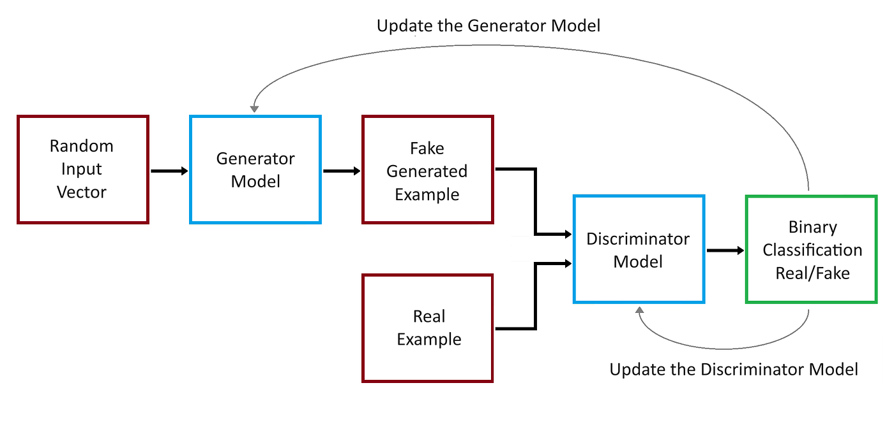
Generative Adversarial Network
2014
Objective Function
GAN's objective function at its optimal point
In this project Generator takes Random noise which represents Initial momentum and outputs -ΔP,Δθ,Δr

Slide 6
Why Choose a GAN? Strengths & Challenges
Pros: The Advantages of Using a GAN
Very Detailed & Sharp Generation
Implicit Learning of Complex Distributions
Cons: The Challenges of Training a GAN
Training Instability
Hyperparameter Sensitivity
Mode Collapse
Poor Mode Coverage

Slide 7
Data Scaling: A Critical Step for GAN Training
Finding the Best Data Transformation
The Problem: Scaling's Impact on Data Distribution
Raw physics data is challenging. Variables like momentum span many orders of magnitude, which is problematic for neural networks.
Scaling data to the range of [-1, 1] is a critical preprocessing step for training most Generative Adversarial Networks (GANs), primarily to ensure training stability and effective learning.
But Scaling leeds to Distortion in the underlying distribution of the Data which can observed using 1 D histogram plot, and one specific to this project 2D Correlation plot.

Slide 8
GANDataset_test
Function: Takes the raw .root file and applies all the mentioned, Normalization Techniques:
Setup & Configuration
__init__(self, ...): Initializes the experiment by setting up the list of transformations to test.
plotting_config(self): Provides a centralized dictionary of labels and settings for consistent plotting.
Core Data Processing
process(self): Orchestrates the entire data processing pipeline from raw data to final scaled results.
apply_transformations_by_X0(self, ...): Manages the experiment by applying all transformations to data grouped by material.
apply_single_transformation(self, ...): Contains the specific implementation for each of the 8 scaling methods.
Utility & Helper Functions
make_mask(self): Cleans the data by filtering out non-physical simulation steps.
apply_log_transform(self, data): A math utility to safely apply a natural log transformation to data.
safe_awkward_to_numpy(self, awkward_array): A data conversion utility to safely handle and convert jagged arrays to NumPy arrays.
Data Access
get_transformed_data(self, ...): A public "getter" method to easily retrieve specific slices of transformed data.
list_available_transformations(self): A helper function that returns the list of all valid transformation names.

Slide 9
Custom Plot-Function
The plot_2d_correlations_by_transformation function acts as an automated report generator for visually inspecting data correlations. It systematically creates a series of figures: one for the original, unscaled data, and then an additional figure for each data transformation method that was tested (e.g., LogMinMax, Tanh). Each figure contains a grid of 2D histograms, or "heatmaps," where the rows represent different materials (like Lead or Air) and the columns show the relationships between pairs of key physical variables, such as momentum versus scattering angle. The primary goal of this function is to allow a direct, side-by-side comparison to verify that a chosen scaling method does not destroy the essential physical correlations present in the original data, which is a critical step before training the GAN.
The plot_distributions function, in contrast, provides a detailed comparison of how different scaling methods affect the distribution of each individual physics variable. It generates two distinct figures to achieve this. The first, smaller figure displays the 1D histograms of the original, unscaled data on a logarithmic scale, serving as the ground-truth baseline. The second, larger figure shows the distributions of the preprocessed data. Crucially, on each subplot, it overlays the results from all tested scaling methods in different colors. This allows for a direct visual assessment of how each transformation reshapes the data, helping to identify which methods best preserve the overall structure or make the distribution more suitable for a neural network.

Slide 10
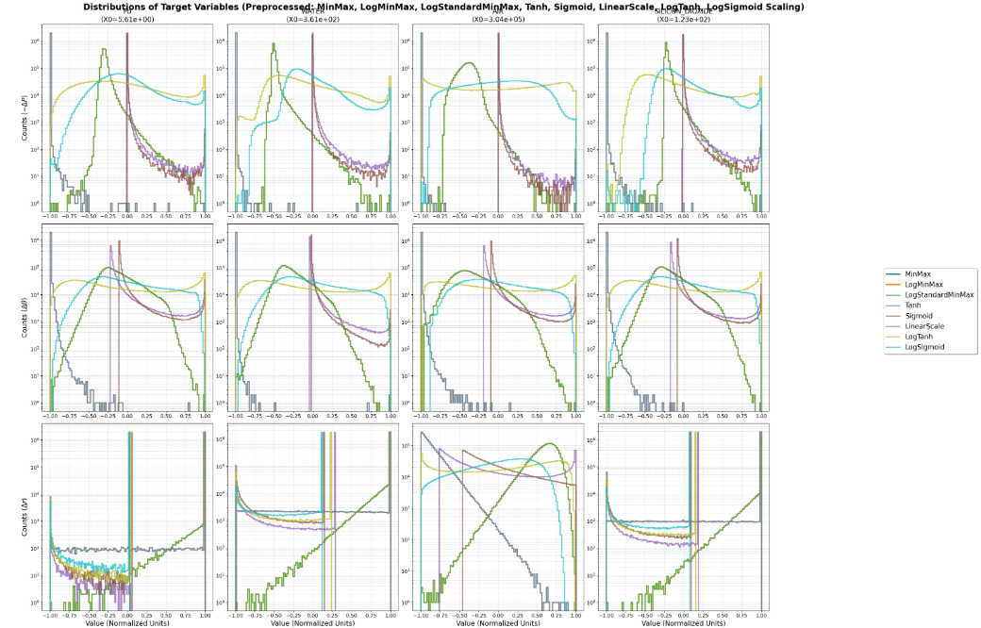
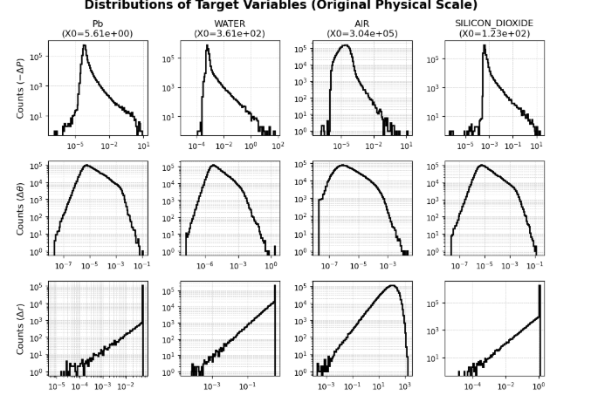
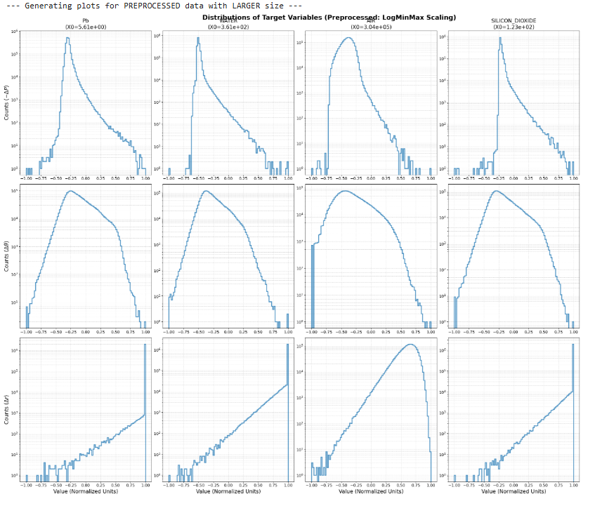
1D Distribution Plot
Original Distribution
Log min max & log standard min max

Slide 11
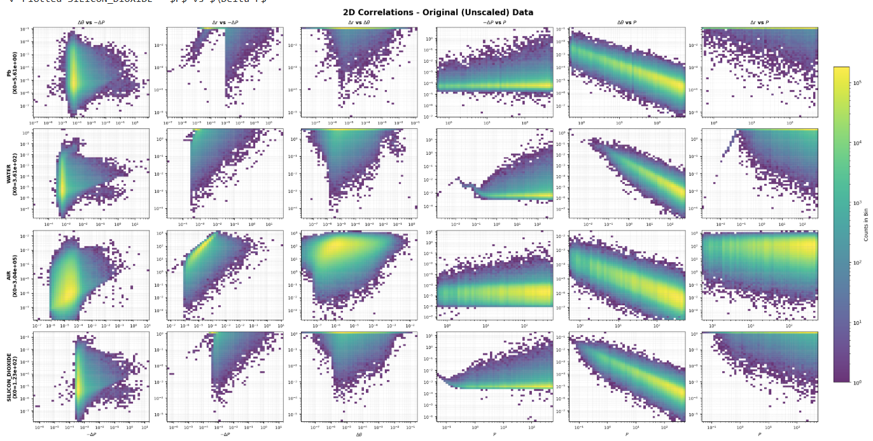
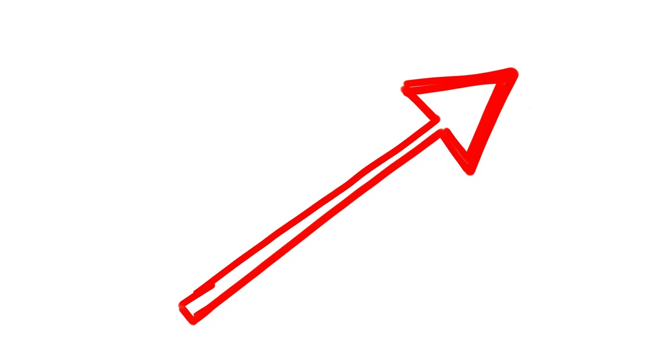
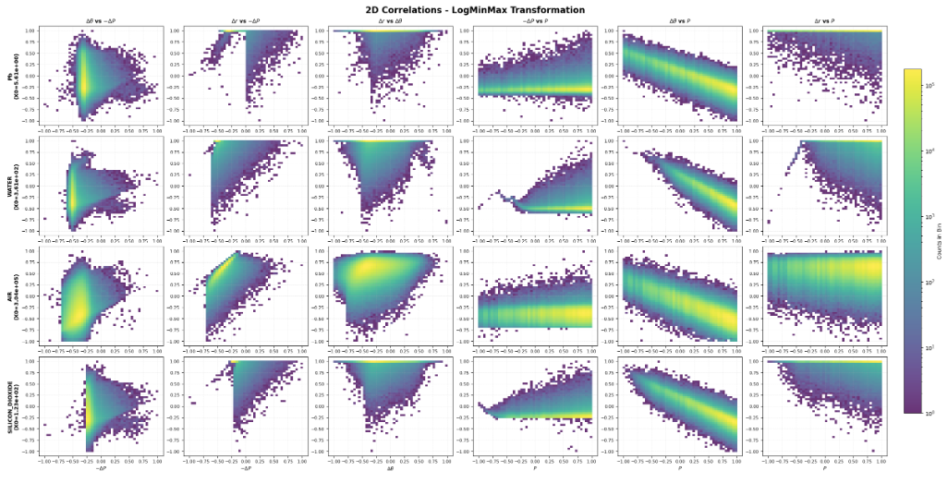
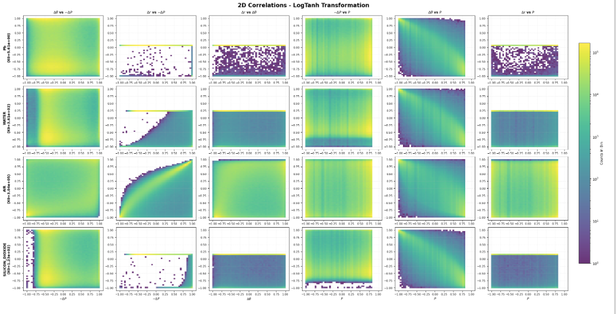
2 D Correlation Plot
Original 2d plot
Log Sigmoid
Log Min Max & Log standard Min Max

Slide 12
Optimal Discriminator Configuration with Optuna
. The Challenge: Achieving Adversarial Balance
GAN training requires a delicate balance between the Generator (G) and Discriminator (D).
Weak Discriminator: Provides poor gradients, leading to slow or no improvement in the Generator.
Strong Discriminator: Overpowers the Generator, causing gradients to vanish and training to stop.
Complex Hyperparameter Space: The ideal configuration depends on interdependent factors like network depth, learning rate, and optimizer settings, making manual tuning ineffective
2. The Solution: Automated Hyperparameter Optimization:
Optuna Framework: Used to automate the search for optimal discriminator parameters.
TPE Algorithm: Employs a Bayesian optimization strategy (Tree-structured Parzen Estimator) to intelligently explore the hyperparameter space.
Models "good" (ℓ(x)) and "bad" (g(x)) configurations based on past trials.
Focuses the search on promising regions by maximizing the ratio ℓ(x)/g(x).

Slide 13
Search Strategy and Implementation
search Space: Definitions of Key Hyperparameters
Learning Rate:
Definition: Controls the step size the optimizer takes during each update. A well-tuned learning rate is crucial for balancing the training speed and stability of both the generator and discriminator.
Adam β1:
Definition: The exponential decay rate for the first moment estimates in the Adam optimizer. It governs the "momentum" of the gradients, determining how much weight is given to past gradient information versus the current gradient.
Network Depth:
Definition: The number of hidden layers in the discriminator's neural network. Deeper networks can learn more complex features but are also more prone to instability and vanishing gradients.
Neurons per Layer:
Definition: The number of neurons in each hidden layer. This determines the model's capacity—its ability to represent and learn complex patterns from the dat.
Objective: Minimize discriminator validation loss (Binary Cross-Entropy) over a fixed number of epochs.
Efficient Pruning:
Threshold Pruning: Terminated trials if loss dropped below 0.1 (to prevent an overly dominant discriminator).
Median Pruner: Stopped trials performing worse than the median of their peers.

Slide 14
Results from Optuna
'Pb', 'AIR', 'Water', 'SILICON_DIOXIDE' Data
Pb Data
Best Hyperparameters:
lr: 3e-05
beta1: 0.5682096494749166
d_layers: 2
d_neurons: 128
^{best_lr = 3e-05}
best_beta1 = 0.5758339373578758
^{best_d_layers = 6}
^{best_d_neurons = 512}
Key Insight on β1: The Adam optimizer's β1 parameter was found to be the most critical hyperparameter. It controls the momentum of the gradients, determining how much information from past updates is retained, which is crucial for stabilizing the adversarial dynamic. A lower Beta 1 Parameter worked the best compared to
Generator also uses the same parameter

Slide 15
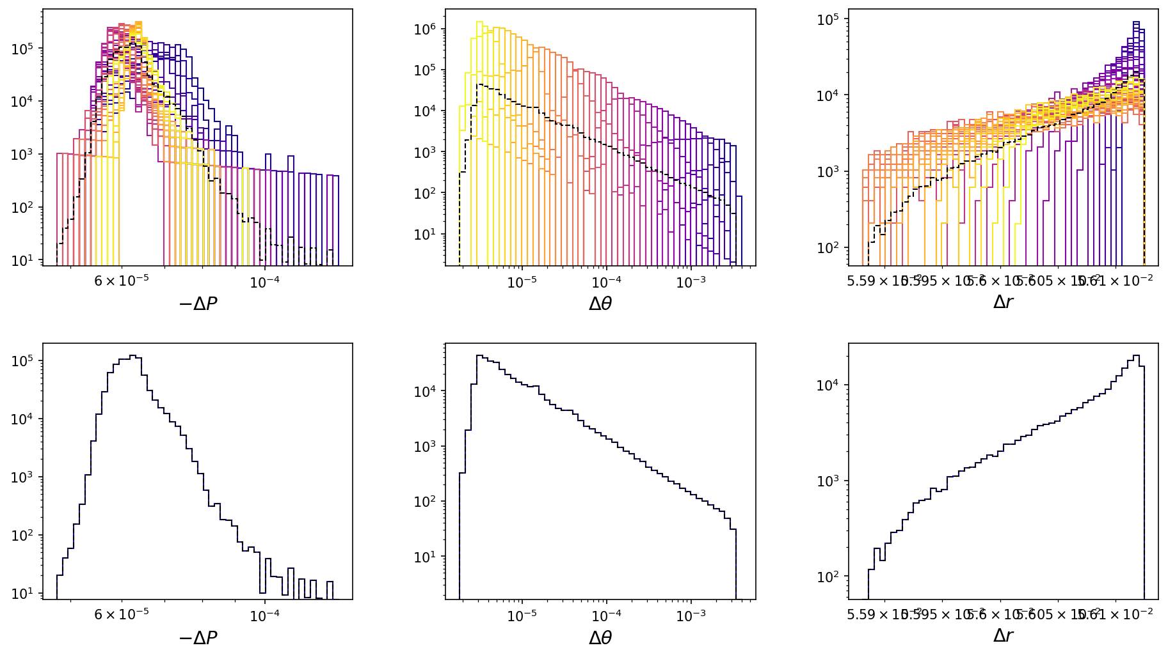
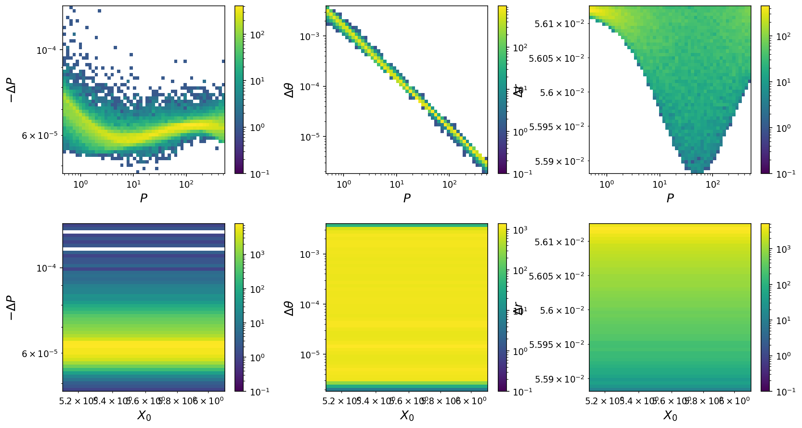
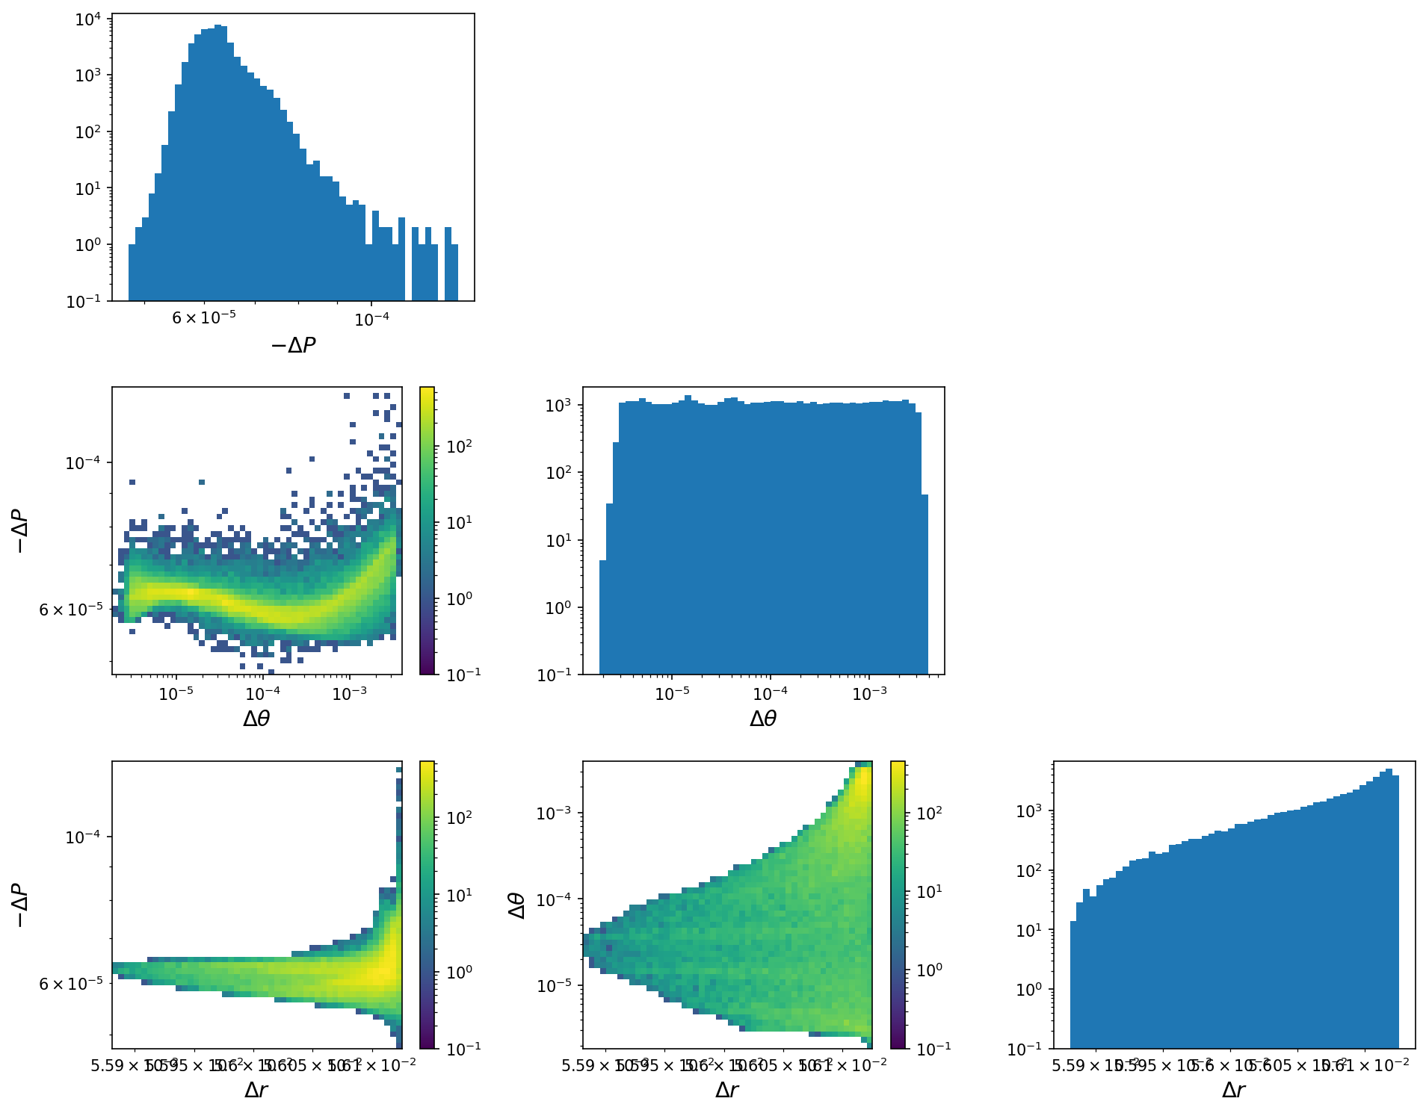
Results of Vanila GAN on Pb Data
1D Plot
Correlation plot with P
2D sampling pair

Slide 16
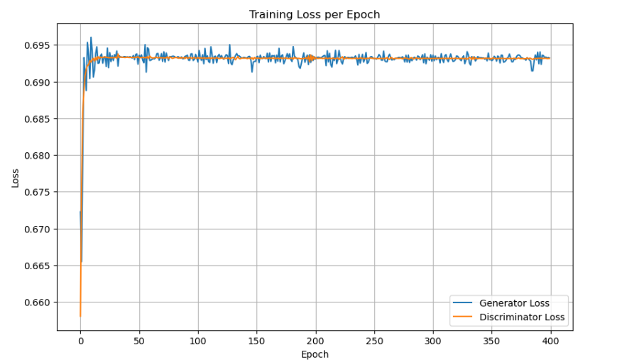
Generator and Discriminator Loss

Slide 17
Stabilizing techniques for GAN
The Core Problem: Standard GANs are notoriously unstable. The adversarial "game" can easily break down, causing the models to stop learning. We implemented several key techniques to ensure a stable and successful training process. 1.Normalization :
Adjust the inputs or activations in neural networks like MLPs to maintain consistent scales.
Reduces internal covariate shifts
more stable gradient descent in MLPs.
It improves sample quality and speeds up convergence, as shown in comparisons of methods
Types of Normalization Tested here : Batch Normalization, Spectral Normalization, layer Normalization.
2>Changing the Objective Function:
In this project WGAN is used

Slide 18
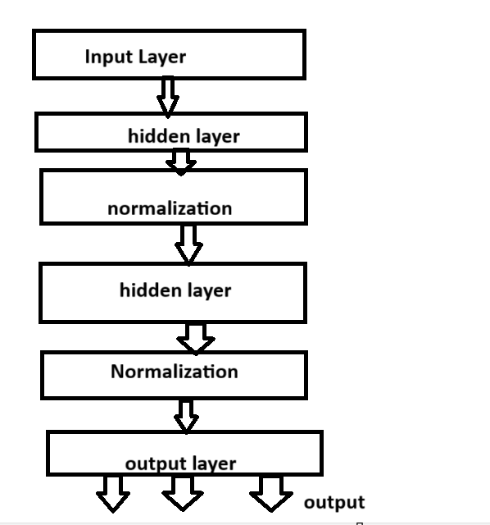
How Normalization is Applied
Applied within each hidden layer, just before the activation function
Batch normalization works only on generator, in discriminator it destabilize the GAN
Spectral normalization works only on generator, in discriminator it destabilize the GAN same as batch
Layer Normalization: a

Slide 19
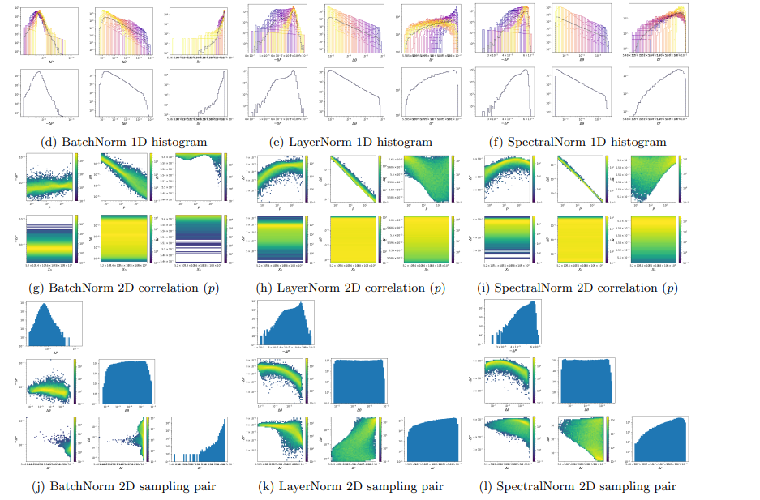

Slide 20
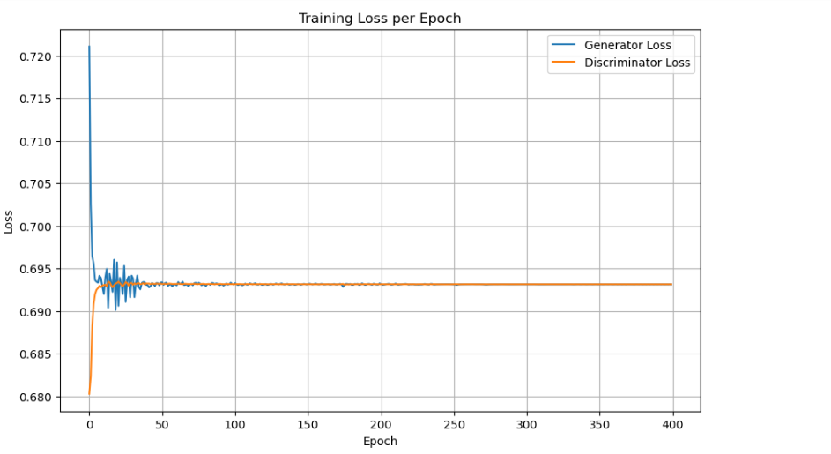
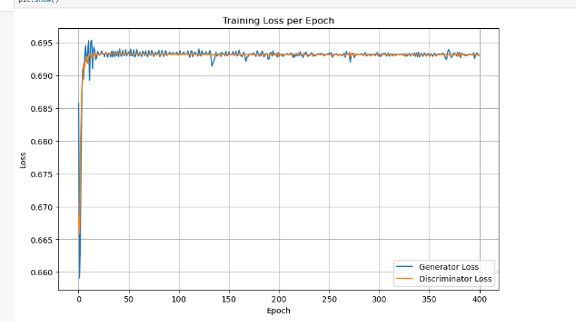
Training Loss For each Type of normalization
Spectral normalization
Batch normalization
Layer normalization

Slide 21
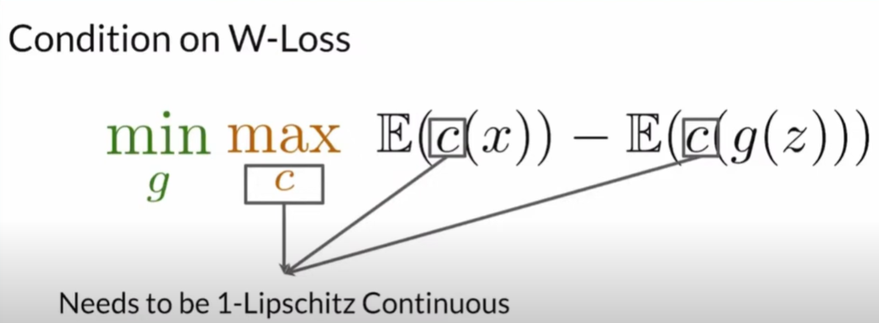
Wasserstein GAN
Wasserstein GAN (WGAN) is a type of Generative Adversarial Network (GAN) that uses the Wasserstein distance (also called Earth Mover’s Distance) as a measure of how different the generated data distribution is from the real data distribution.
Advantages:
Enhances training stability by providing smooth, meaningful gradients even for disjoint distributions, reducing vanishing gradient issues.
Mitigates mode collapse, enabling diverse sample generation without generator collapse to limited modes.
Offers better convergence and higher-quality outputs, with more interpretable loss approximating real distribution distance.
Avoids zero-sum game dynamics, allowing cooperative minimization for reliable training in complex tasks like physics simulation
Disadvantages:
Requires enforcing 1-Lipschitz continuity (e.g., via weight clipping or gradient penalty), which can be computationally expensive and push weights to extremes.
May need more tuning and can converge slower in some scenarios compared to vanilla GANs.
Not universally superior; performs variably depending on data and application, with potential stability issues if constraints are violated
Critirc ‘C’ wants loss to be as high as possible

Slide 22
Wasserstein Gan Variants
Regularization and Normalization in GANs
Hyper parameters for
Here Two Variants of Wasserstein were explored one using weight clipping and using spectral Normalization: Variant 1: Weight Clipping (Original WGAN):
How it Works: Clips critic weights to a fixed range (e.g., [-0.01, 0.01]) after each update to approximate 1-Lipschitz continuity, preventing the critic from becoming too sensitive.
Advantages: Simple to implement; provides basic stability by bounding weights and reducing vanishing gradients.
Disadvantages: Can lead to suboptimal capacity (weights pushed to extremes), causing vanishing/exploding gradients or poor convergence; often requires careful tuning of clipping range.
Variant 2: Spectral Normalization (SN in WGAN):
How it Works: Normalizes the spectral norm (largest singular value) of each weight matrix to 1 using power iteration, directly enforcing the 1-Lipschitz constraint without clipping.
Advantages: Improves stability and avoids weight extremes; allows higher critic capacity for better gradients and sample quality; computationally efficient with one power iteration per update.
Disadvantages: Approximation may not perfectly enforce Lipschitz in complex networks; can be unstable without additional tricks like gradient penalty; requires careful integration with WGAN loss
N_critic = 5
Weight clipping = 0.01

Slide 23
WGAN Training Steps
1. The critic network is first trained on a real batch of data, then trained on a batch of data generated from a noise prior via the generator.
2. The critic's loss function is arranged such that it estimates the Wasserstein Distance (maximizes the distance between the two distributions) > then clips its own weights to ensure it is 1-Lipschitz-Continuous.
Note: The critic's loss is an approximation of the negative Wasserstein distance between the generator distribution and the data distribution.
3. Then, the generator generates a new batch of images from a noise prior, passes these through to the critic who then "informs" the generator of the Wasserstein-1 distance between the true distribution and the distribution of the images the Generator just created.
4. It does this via the loss function of the critic. The critic's weights are frozen and the error propagates all the way back through to the generator who then updates its parameters to minimize the Wasserstein distance.
5. This repeats until the loss (hopefully) converges to near zero and the distributions are approximately equal

Slide 24
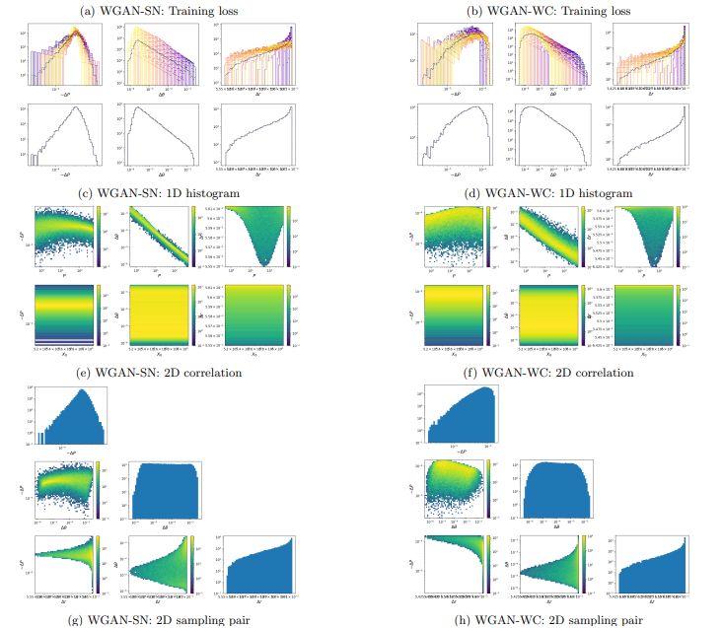
Outputs Of Wasserstein Gans

Slide 25
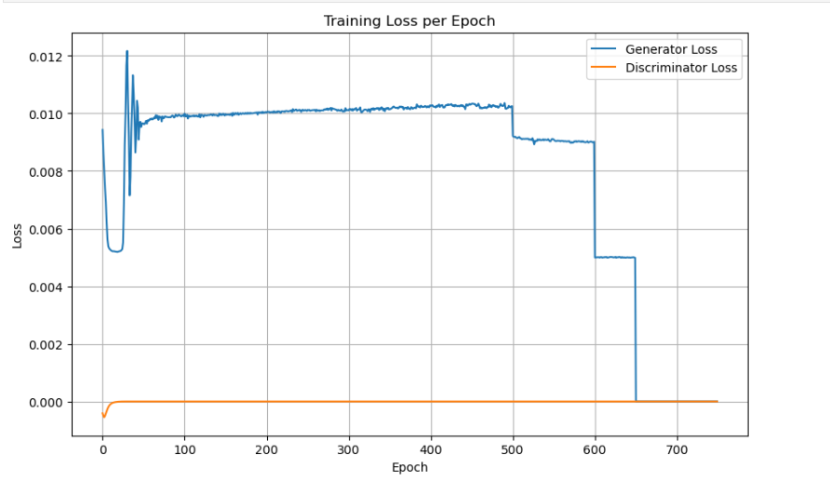
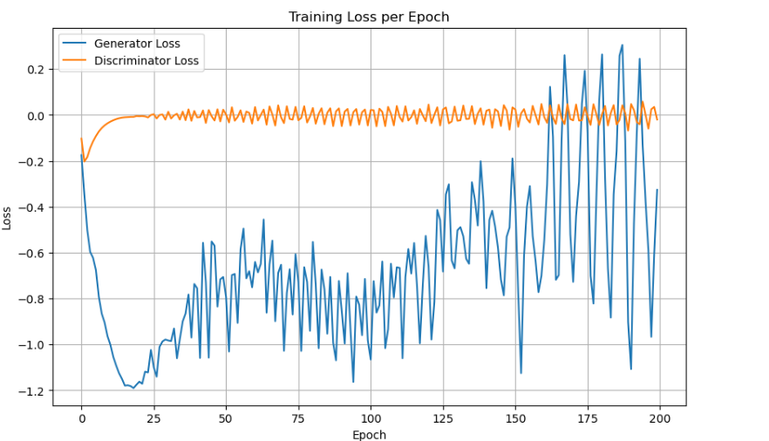
Training Loss for Wassertien GAN
WGAN- spectral normalization
WGAN - weight cliping

Slide 26
The Model: From Vanilla GAN to Conditional GAN
he Vanilla GAN A standard GAN learns the overall distribution of the data but offers no control over its output. It is like an artist who can paint in a certain style but cannot take requests. This serves as the performance baseline in the project.
The Extension: Conditional GAN (cGAN) for Controlled Generation The cGAN is a direct extension of the original model. Its purpose is to allow control over the generator's output by providing an extra piece of information, a "condition" or label (y).
The Key Insight: Same Game, New Rule
The underlying training process is identical to a Vanilla GAN. It still uses the same core objective function (the minimax game between the Generator and Discriminator).
The only difference is that every decision is now conditional. Both the Generator and the Discriminator are shown the condition y, forcing them to make their moves based on that specific context.
Why This is Critical for the Project This allows for a direct performance comparison of GAN on different materials Data

Slide 27
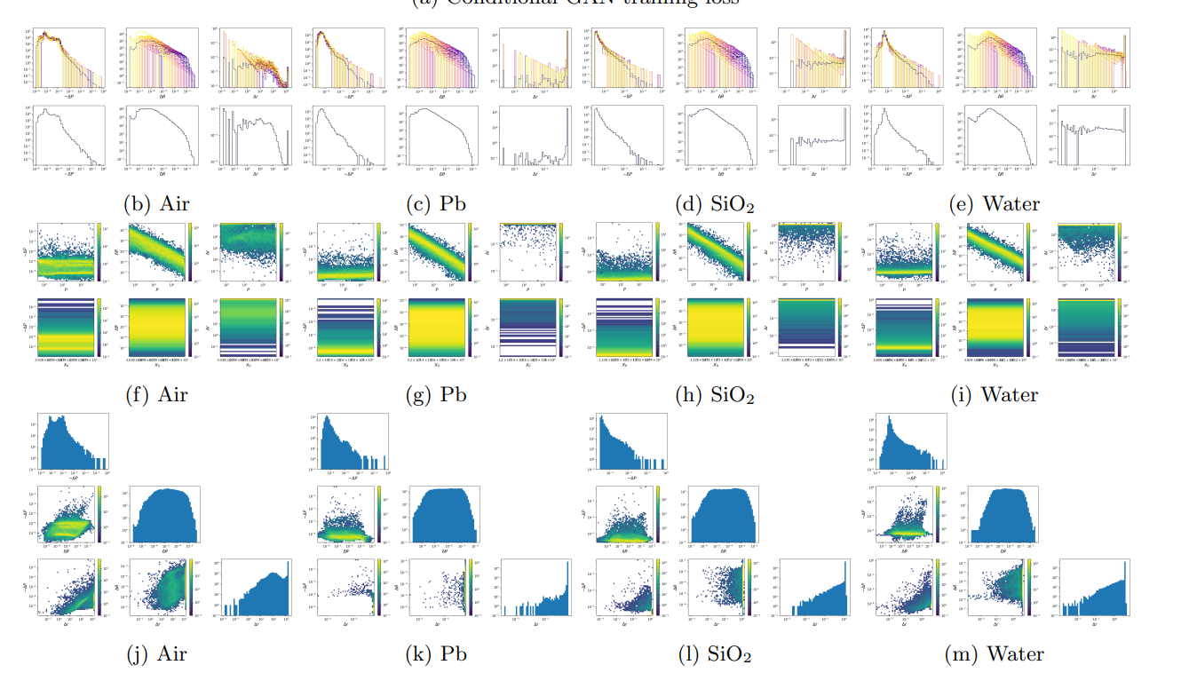
Output Of Conditional GAN

Slide 28
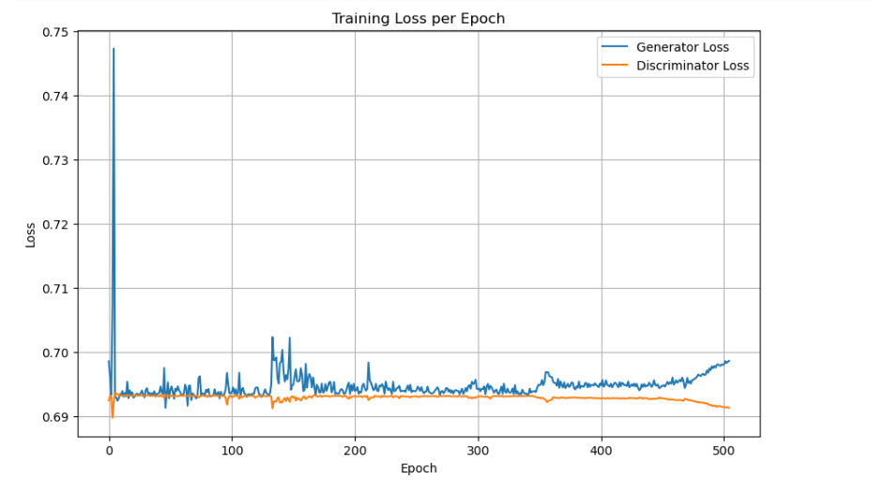
Training Loss for Conditional GAN

Slide 29
Final Take
Gan with Parameters optimized with Optuna performs Better than All of the other techniques, In future, if instability is observed in GAN then the explored stabilizing techniques can be explored

Slide 30
Future work
Next Step: Test for Cumulative Physical Accuracy
The definitive test is to evaluate the GAN's performance over a full, multi-step muon track.
This will be performed using the GANPropagator framework which is still a work in progress, which was developed as part of this project. The propagator uses the trained GAN as an engine to simulate complete trajectories.
Then bench mark it’s performance

